Slide 1

2025 UBS Finance Challenge ~ Pair Trade Stock Pitch
Region：Hong Kong Stock Market
Sector：Industrial ( Automobile)
Prepared by Team of AlphaStock
Mr. Wen Jie (Menger)
The Chinese University of Hong Kong, Shenzhen (May 2027)
Mr. Fang Mingxiang (Jack)
Macalester College, USA ( May 2028 )

Slide 2
Summary of Rationale
01
Table of Contents
Industry and Company Overview
02
Valuation Comparison
03
Fundamental Catalysts & Risks
04
Technical Analysis
05
Risk Factors & Mitigation
06

Slide 3


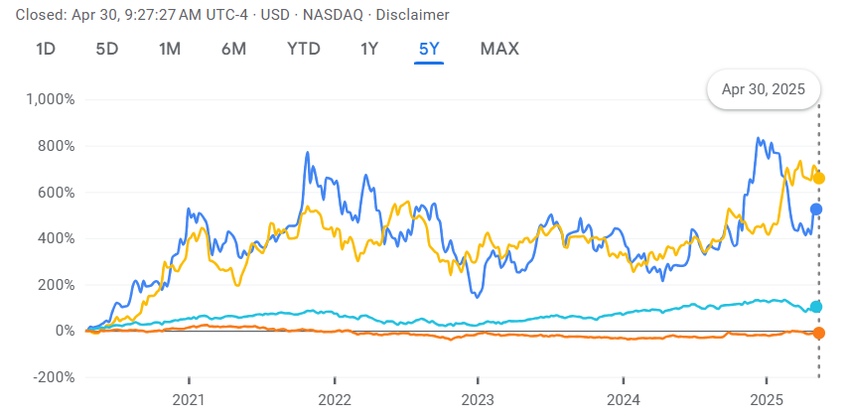


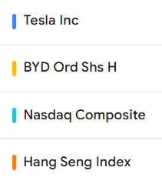
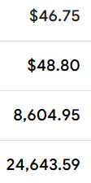
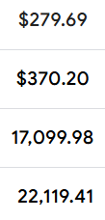
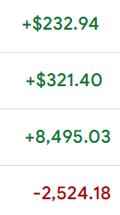
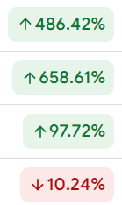
Summary of Rationale - Long Tesla (Tsla.US) Short BYD (1211.HK)
Quantitative Methodology
  BYD and Tesla’s price spread is statistically robust and mean-reverting based on past 5-year stock price trend
  ARIMA model predicts the BYD-Tesla price spread will decrease from 0.039 to its average by mid-May 2025
Business and Financial Analysis
  Collaborate to generate innovative ideas for product positioning, pricing, and promotional campaigns.
  Consider various channels such as online platforms, partnerships, and offline marketing.
5-yr Growth %
Qualitative Assessment
  Pilot the proposed strategies on a smaller scale to assess their effectiveness.
  Gather feedback, iterate, and refine the strategies based on initial results.

Slide 4


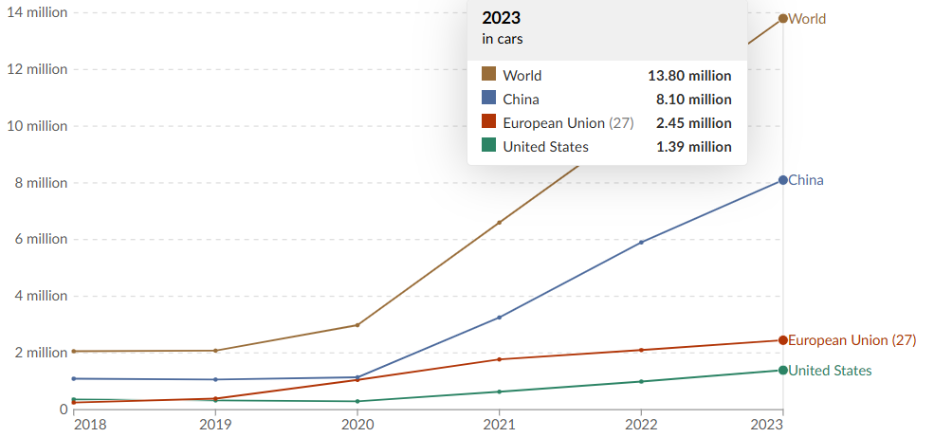
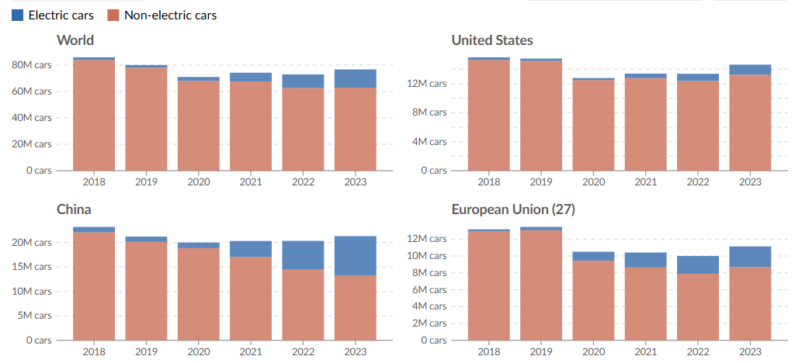


EV Industry - Long Tesla (Tsla.US) Short BYD (1211.HK)
Why Electric Vehicle (EV) Sector?
In 2024, the global electric vehicle (EV) market achieved 25% growth to sales of 17 million units (both BEVs and PHEVs) or $380 billion and expected to surpass 20 million units in 2025, approximately 20% penetration of global car sales
Top two leaders: BYD (22% of global market) with volume-driven strategy vs Tesla (17% of global market) with platform economics
EV sector has exhibited divergent price volatility in Hong Kong and NASDAQ market, reflecting distinct geopolitical, regulatory, and market structure dynamics. The 3-year average volatility of stock prices of EV indices in both markets is 36% (HK) and 29%(NASDAQ)
8.9%
14%
18%
5%
7%
9.5%
16%
29%
38%
17%
21%
22%

Slide 5
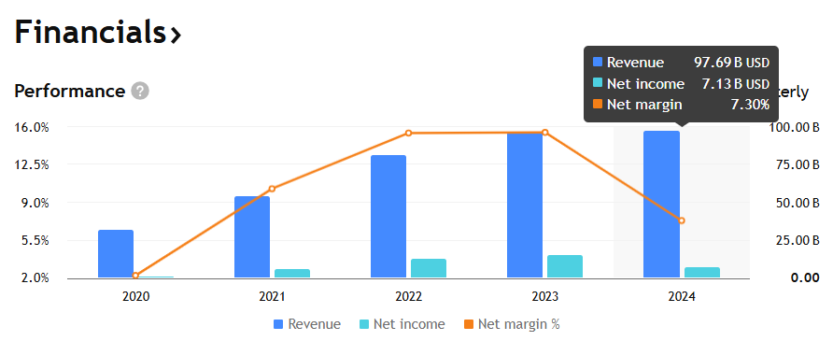
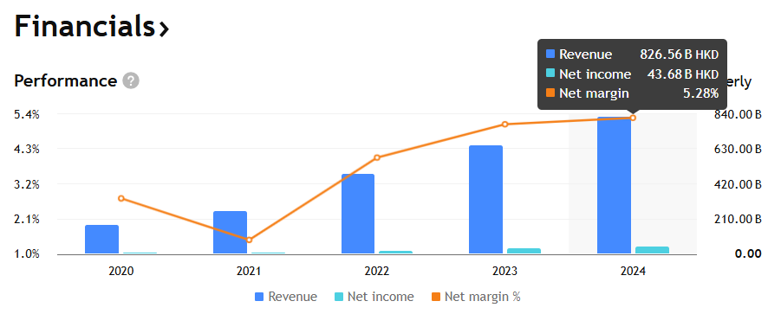
Business and Financial Analysis (1) - Long Tesla (Tsla.US) Short BYD (1211.HK)
Why Long Tesla?
Historical Performance
  4-yr CAGR of 33% in revenue and 79% in net profit, implying more profitable and faster bottom line growth than that of BYD
Valuation Adjustment Catalysts
  Full Self-Driving (FSD) Adoption will launch in Austin in June 2025, targeting $0.25/mile vs. Uber’s $1.50 could capture 5% of the US ride-hailing market by 2026, adding $4.2 billion in EBITDA
  Tesla’s energy storage (18% of total revenue) provides a hedge against automotive cyclicality for long-term upside
  Tesla’s pivot to AI and robotics leverages its software expertise to unlock higher-margin revenue streams, justifying its premium valuation

Slide 6
Business and Financial Analysis (2) - Long Tesla (Tsla.US) Short BYD (1211.HK)
Why Short BYD ?
Historical Performance
  BYD’s Free Cash Flow (FCF) margin declined from 10.3% in 2022 to 6.4% in 2024 despite higher volumes
Valuation Adjustment Catalysts
  BYD’s current low P/E multiples reflect market skepticism about sustaining margins amid price wars. 10% decline in average selling price (ASP) would erase 2025E net income growth despite volume gains
  BYD’s lower R&D capitalization (currently 2% vs. Tesla’ 14%), eroding its value proposition and reliance on China government subsidies (12% of 2024 revenue) might not sustain in the future.
  Trade Barrier: EU imposed 17–36% tariffs and the US hiking duties to 145% will bring geopolitical disruptions to BYD’s export-led growth
  BYD’s local production is time-consumed and the competition in China market is more fierce
Valuation Indicator | Tesla (Tsla.US) | BYD (1211.HK)
2025E Revenue Growth% | 12% | 30%
2025E Net Margin | 8.2% | 5.1%
P/E(x) 2025E | 58x | 17x
EV/EBITDA (x) 2025E | 34x | 9x
R&D % revenue | 14% | 2%
3-yr Cum. Capex / FCF (1) | 2.7x | 3.2x
3-yr Cum. FCF / Delivery (1) | $5,872 | $3,961
[1] Cumulative Free Cash Flow for the years from 2022 to 2024

Slide 7
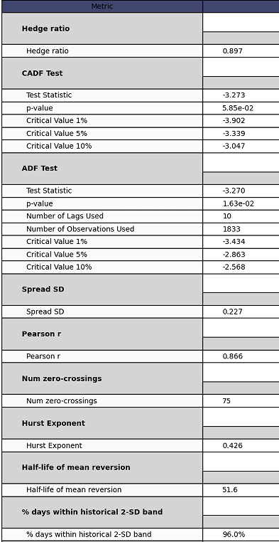
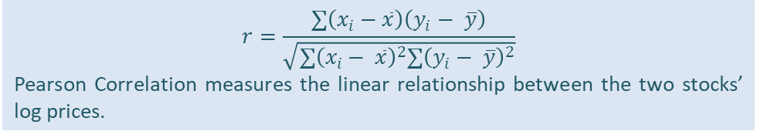
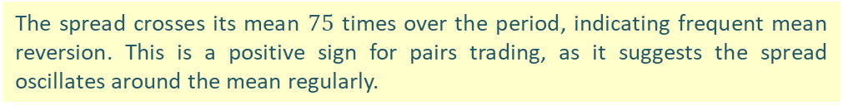
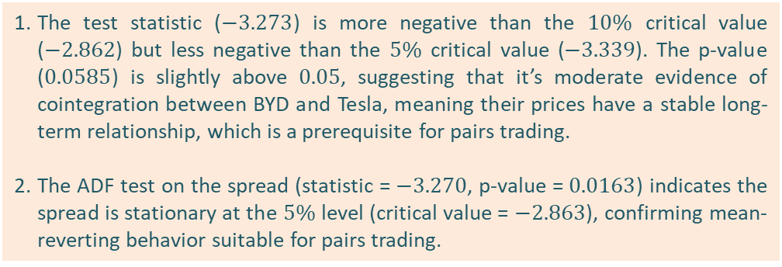
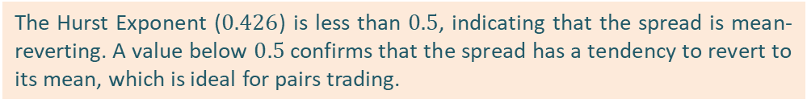
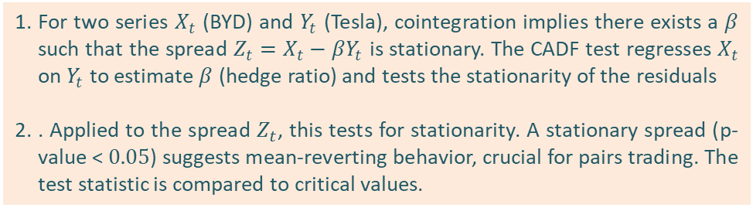
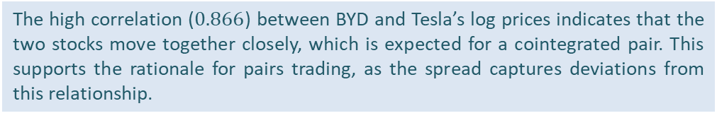
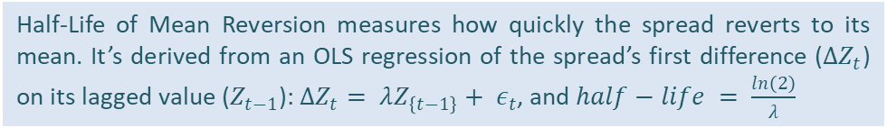

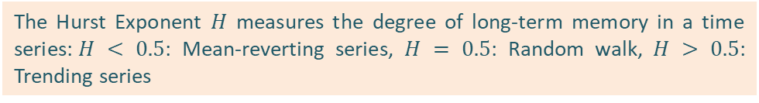
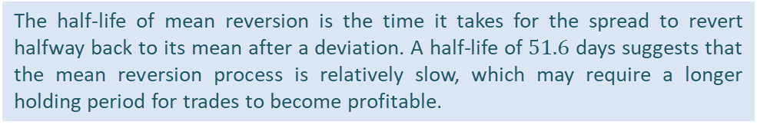
Quantitative Analysis (1) - Long Tesla (Tsla.US) Short BYD (1211.HK)
Correlation and Cointegration Analysis
Multiple statistics show BYD and Tesla stock prices move together, making them suitable for pairs trading as their price difference often returns to a predictable average.
Mathematical Notes
Statistics Implication
The hedge ratio ($β$) is computed using OLS regression on log prices of BYD ($X_{t}$) and Tesla ($Y_{t}$):$X_{t}=α+βY_{t}+ε_{t}$
Here, $β= 0.897$ indicates that for a $1\%$ change in Tesla's log price, BYD's log price changes by $0.897\%$.,The spread is then: $Z_{t}=X_{t}−βY_{t}$
The test statistic ($−3.273$) is more negative than the $10\%$ critical value ($−2.862$) but less negative than the $5\%$ critical value ($−3.339$). The p-value ($0.0585$) is slightly above $0.05$, suggesting that it’s moderate evidence of cointegration between BYD and Tesla, meaning their prices have a stable long-term relationship, which is a prerequisite for pairs trading.
The ADF test on the spread (statistic = $−3.270$, p-value = $0.0163$) indicates the spread is stationary at the $5\%$ level (critical value = $−2.863$), confirming mean-reverting behavior suitable for pairs trading.
For two series $X_{t}$ (BYD) and $Y_{t}$ (Tesla), cointegration implies there exists a $β$ such that the spread $Z_{t}=X_{t}−βY_{t}$ is stationary. The CADF test regresses $X_{t}$ on $Y_{t}$ to estimate $β$ (hedge ratio) and tests the stationarity of the residuals
. Applied to the spread $Z_{t}$, this tests for stationarity. A stationary spread (p-value < $0.05$) suggests mean-reverting behavior, crucial for pairs trading. The test statistic is compared to critical values.
The high correlation ($0.866$) between BYD and Tesla’s log prices indicates that the two stocks move together closely, which is expected for a cointegrated pair. This supports the rationale for pairs trading, as the spread captures deviations from this relationship.
$$r=\frac{∑\left(x_{i}−\overline{x}\right)\left(y_{i}− \overline{y}\right)}{\sqrt{∑{\left(x_{i}− \overline{x}\right)}^{2}∑{\left(y_{i}− \overline{y}\right)}^{2}}}$$
Pearson Correlation measures the linear relationship between the two stocks’ log prices.
c
The spread crosses its mean $75$ times over the period, indicating frequent mean reversion. This is a positive sign for pairs trading, as it suggests the spread oscillates around the mean regularly.
The Hurst Exponent $H$ measures the degree of long-term memory in a time series:$H < 0.5$: Mean-reverting series, $H = 0.5$: Random walk, $H > 0.5$: Trending series
The Hurst Exponent ($0.426$) is less than $0.5$, indicating that the spread is mean-reverting. A value below $0.5$ confirms that the spread has a tendency to revert to its mean, which is ideal for pairs trading.
Half-Life of Mean Reversion measures how quickly the spread reverts to its mean. It’s derived from an OLS regression of the spread’s first difference ($ΔZ_{t}$) on its lagged value ($Z_{t−1}$): $ΔZ_{t}= λZ_{\left\{t−1\right\}}+ ε_{t}$, and $half−life = \frac{ln\left(2\right)}{λ}$
The half-life of mean reversion is the time it takes for the spread to revert halfway back to its mean after a deviation. A half-life of $51.6$ days suggests that the mean reversion process is relatively slow, which may require a longer holding period for trades to become profitable.

Slide 8
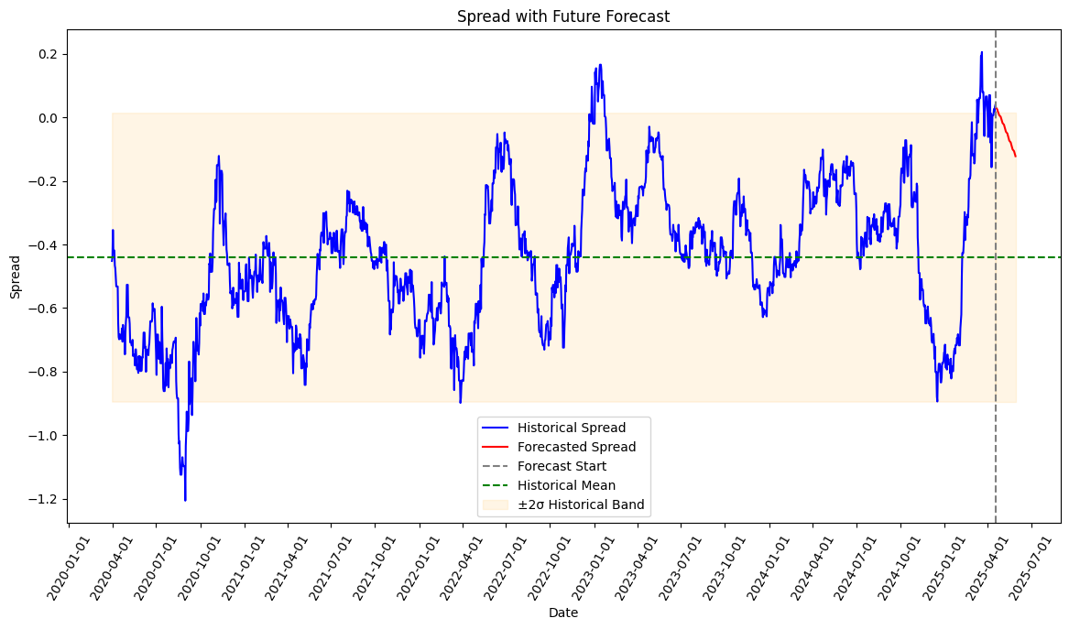
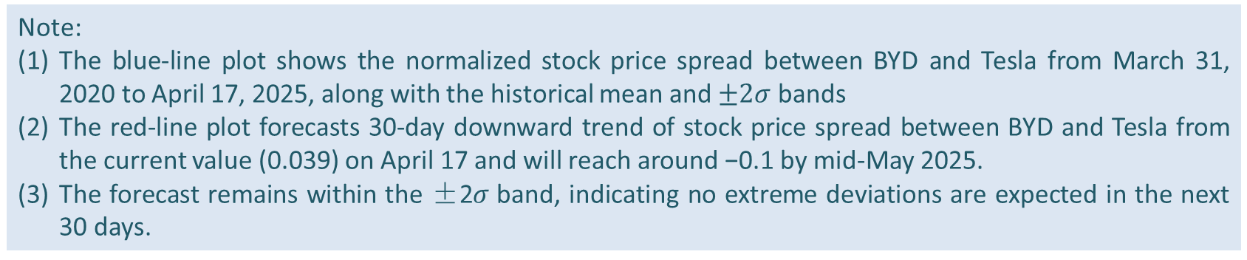
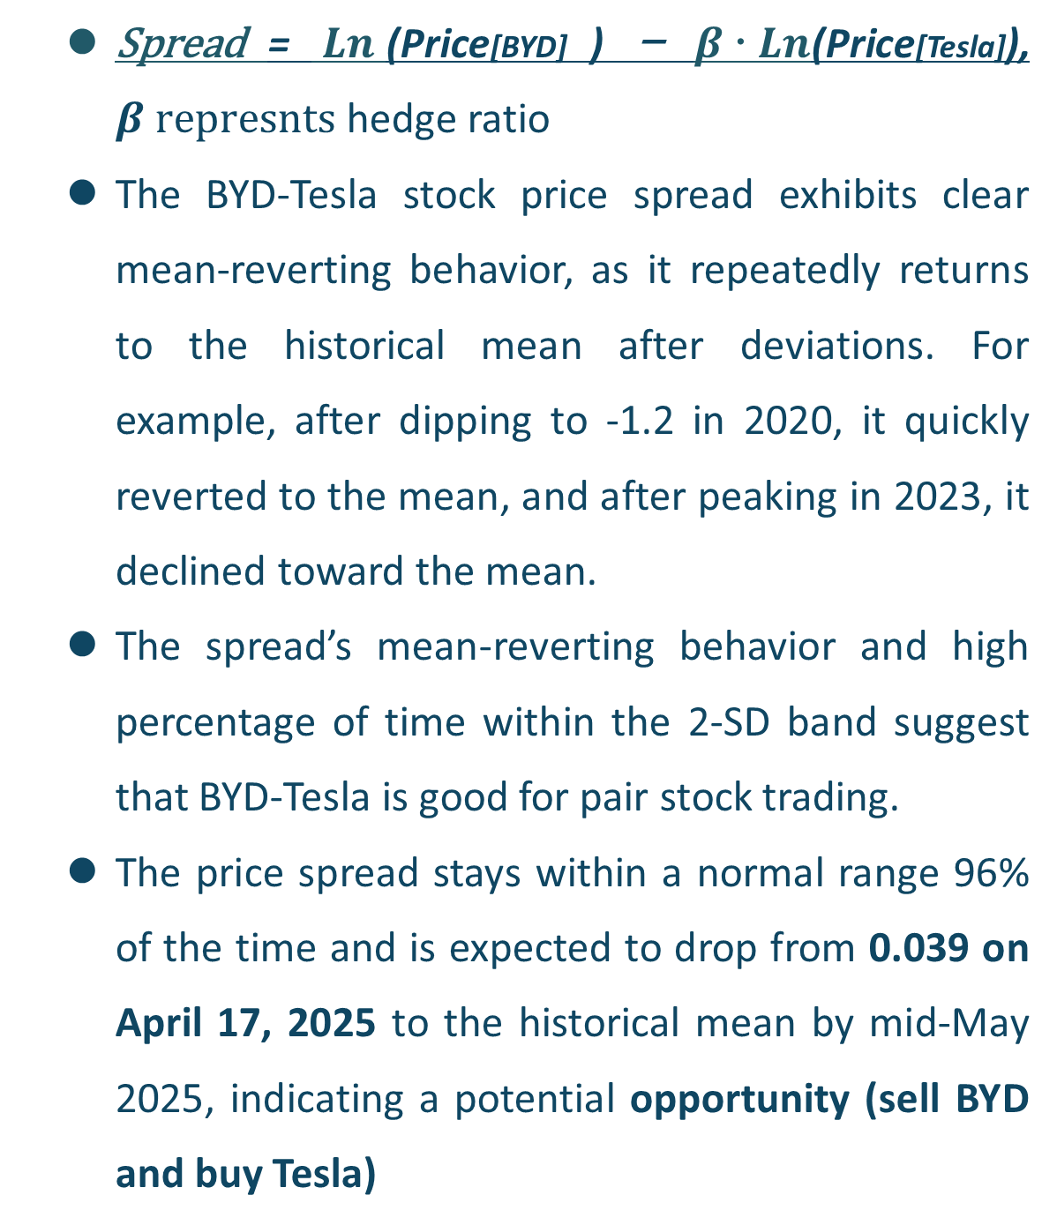
Quantitative Analysis (2) - Long Tesla (Tsla.US) Short BYD (1211.HK)
:
  Value @ 04/17/25 = 0.039
  Spread = $Ln$(Price[BYD] ) － $β  Ln$(Price[Tesla]), $β represnts$ hedge ratio
  The BYD-Tesla stock price spread exhibits clear mean-reverting behavior, as it repeatedly returns to the historical mean after deviations. For example, after dipping to -1.2 in 2020, it quickly reverted to the mean, and after peaking in 2023, it declined toward the mean.
  The spread’s mean-reverting behavior and high percentage of time within the 2-SD band suggest that BYD-Tesla is good for pair stock trading.
  The price spread stays within a normal range 96% of the time and is expected to drop from 0.039 on April 17, 2025 to the historical mean by mid-May 2025, indicating a potential opportunity (sell BYD and buy Tesla)
Note:
The blue-line plot shows the normalized stock price spread between BYD and Tesla from March 31, 2020 to April 17, 2025, along with the historical mean and $±2σ$ bands
The red-line plot forecasts 30-day downward trend of stock price spread between BYD and Tesla from the current value (0.039) on April 17 and will reach around −0.1 by mid-May 2025.
The forecast remains within the ±2𝜎 band, indicating no extreme deviations are expected in the next 30 days.

Slide 9
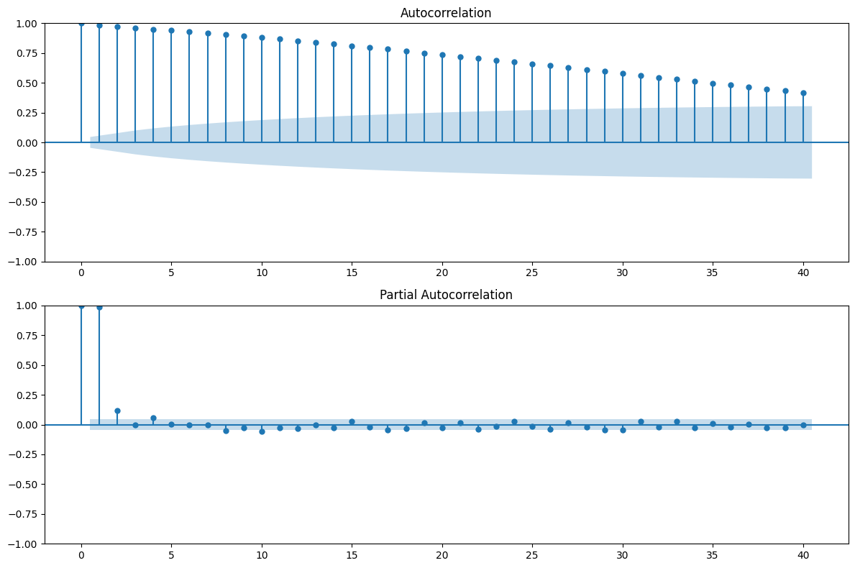
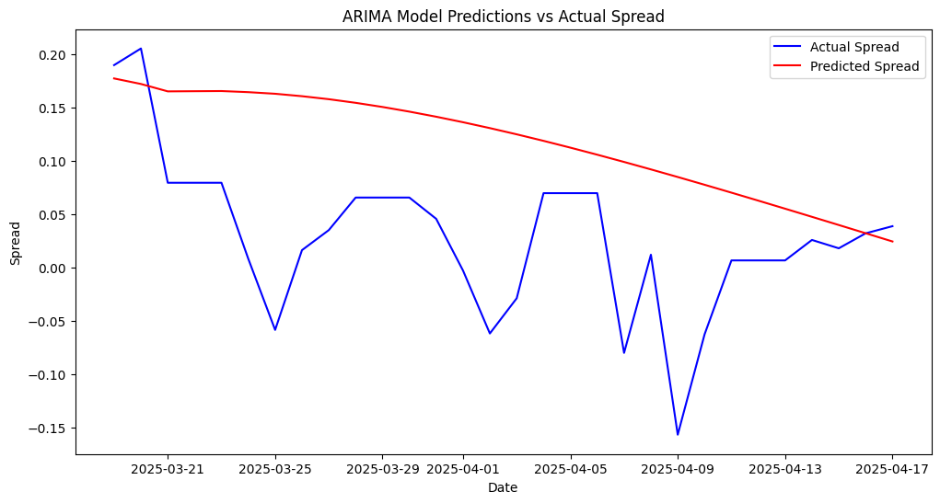
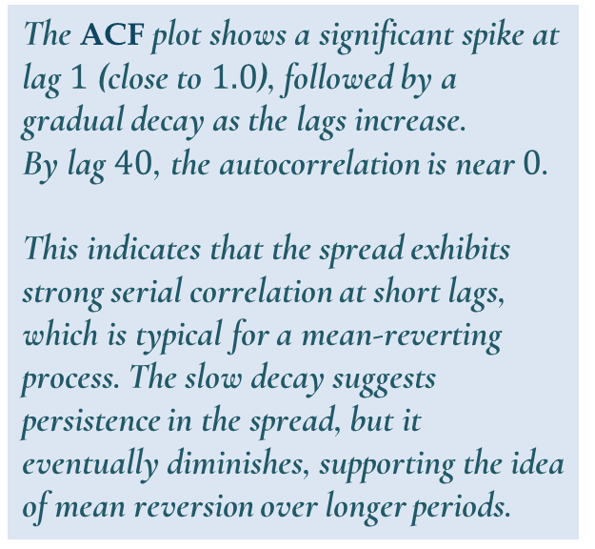
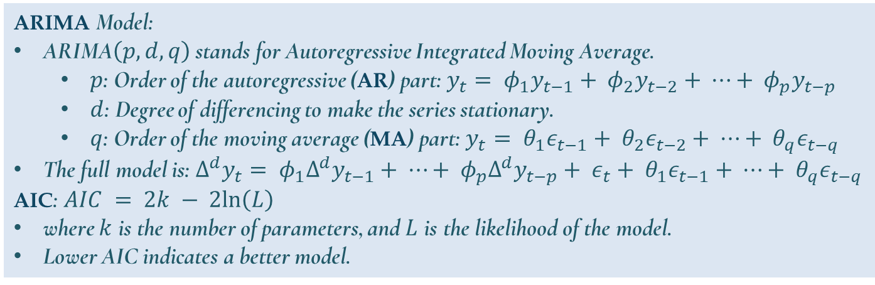
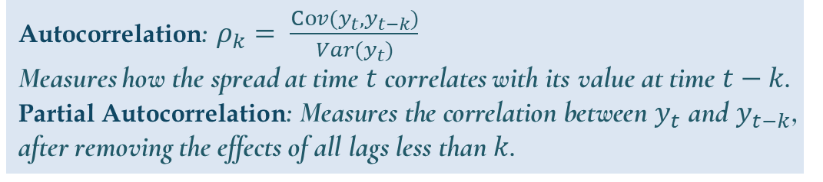
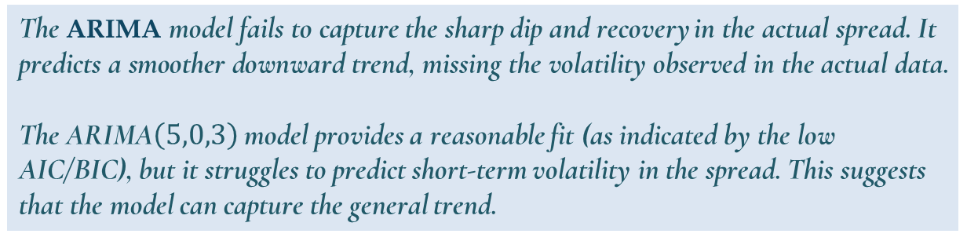
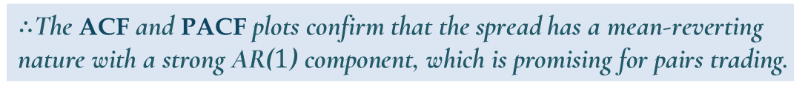
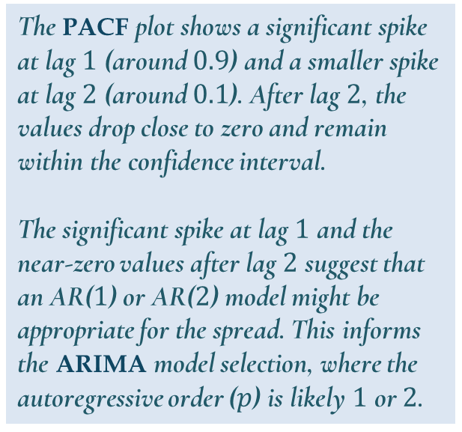
Quantitative Analysis: ARIMA Model
The mathematical basis and forecasting attempt of the ARIMA model, reflecting the accuracy in terms of the general trend.
Autocorrelation: $ρ_{k}= \frac{Cov(y_{t}, y_{t−k})}{Var(y_{t})}$
Measures how the spread at time $t$ correlates with its value at time $t−k$.
Partial Autocorrelation: Measures the correlation between $y_{t}$ and $y_{t−k}$, after removing the effects of all lags less than $k$.
ARIMA Model:
ARIMA$\left(p, d, q\right)$ stands for Autoregressive Integrated Moving Average.
  $p$: Order of the autoregressive (AR) part: $y_{t}= φ_{1}y_{t−1}+ φ_{2}y_{t−2}+ ⋯+ φ_{p}y_{t−p}$
  $d$: Degree of differencing to make the series stationary.
  $q$: Order of the moving average (MA) part: $y_{t}= θ_{1}ε_{t−1}+ θ_{2}ε_{t−2}+ ⋯+ θ_{q}ε_{t−q}$
The full model is: $Δ^{d}y_{t}= φ_{1}Δ^{d}y_{t−1}+ ⋯+ φ_{p}Δ^{d}y_{t−p}+ ε_{t}+ θ_{1}ε_{t−1}+ ⋯+ θ_{q}ε_{t−q}$
AIC: $AIC = 2k − 2ln\left(L\right)$
where $k$ is the number of parameters, and $L$ is the likelihood of the model.
Lower AIC indicates a better model.
The ACF plot shows a significant spike at lag $1$ (close to $1.0$), followed by a gradual decay as the lags increase.
By lag $40$, the autocorrelation is near $0$.
This indicates that the spread exhibits strong serial correlation at short lags, which is typical for a mean-reverting process. The slow decay suggests persistence in the spread, but it eventually diminishes, supporting the idea of mean reversion over longer periods.
The PACF plot shows a significant spike at lag $1$ (around $0.9$) and a smaller spike at lag $2$ (around $0.1$). After lag $2$, the values drop close to zero and remain within the confidence interval.
The significant spike at lag $1$ and the near-zero values after lag $2$ suggest that an AR($1$) or AR($2$) model might be appropriate for the spread. This informs the ARIMA model selection, where the autoregressive order ($p$) is likely $1$ or $2$.
The ARIMA model fails to capture the sharp dip and recovery in the actual spread. It predicts a smoother downward trend, missing the volatility observed in the actual data.
The ARIMA$\left(5,0,3\right)$ model provides a reasonable fit (as indicated by the low AIC/BIC), but it struggles to predict short-term volatility in the spread. This suggests that the model can capture the general trend.
$∴$The ACF and PACF plots confirm that the spread has a mean-reverting nature with a strong AR($1$) component, which is promising for pairs trading.

Slide 10
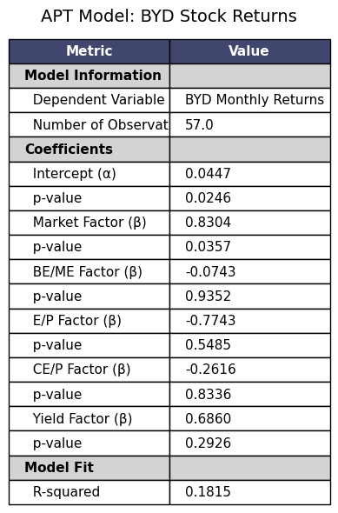
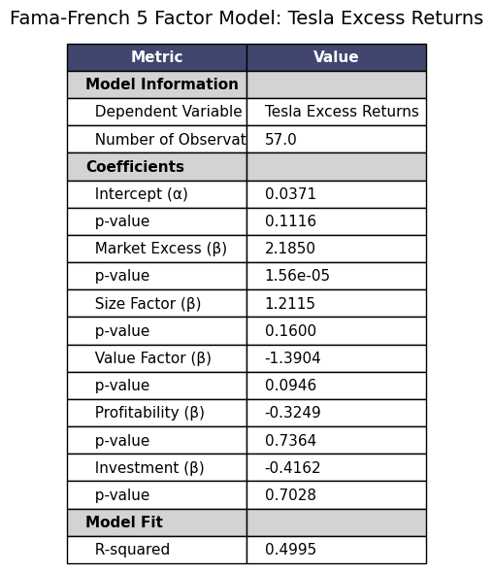
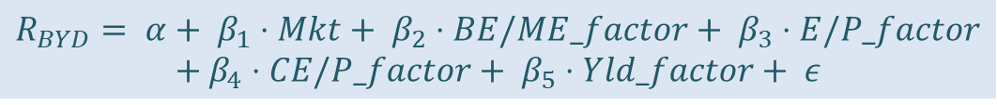
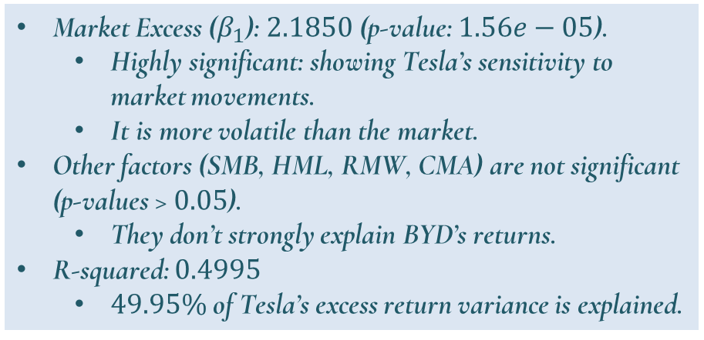
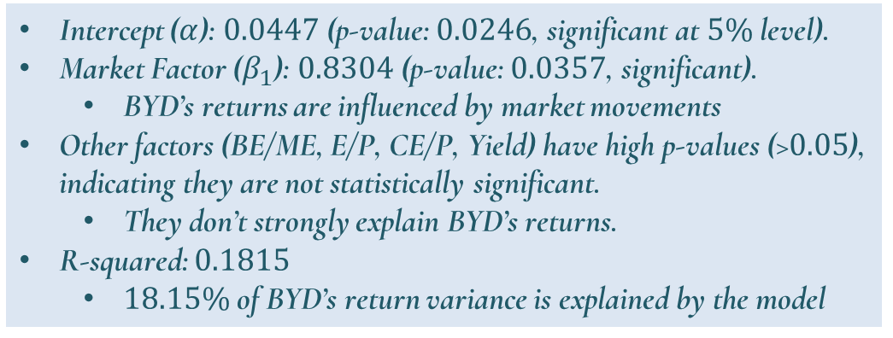
Quantitative Analysis: Market Impact on Share Price
Market movements strongly influence Tesla’s returns (49.95% explained) more than BYD’s (18.15% explained), showing Tesla is more tied to market trends.
Due to the limitation of the data source, only the following factors can be obtained separately.
Independent Variables:
  book-to-market (B/M)
  earnings-price (E/P)
  cash earnings to price (CE/P)
  dividend yield (D/P)
Independent Variables:
  Market excess return (Mkt-RF).
  Size factor (SMB: Small Minus Big).
  Value factor (HML: High Minus Low).
  Profitability factor (RMW: Robust Minus Weak).
  Investment factor (CMA: Conservative Minus Aggressive).
$$R_{BYD}= α+ β_{1}⋅Mkt+ β_{2}⋅BE/ME_factor+ β_{3}⋅E/P_factor$$
$$+ β_{4}⋅CE/P_factor+ β_{5}⋅Yld_factor+ ε$$
$$R_{Tesla}− R_{f}= α+ β_{1}⋅\left(Mkt−RF\right)+ β_{2}⋅SMB+ β_{3}⋅HML+ β_{4}⋅RMW+ β_{5}⋅CMA+ ε$$
Market Excess ($β_{1}$): $2.1850$ (p-value: $1.56e−05$).
  Highly significant: showing Tesla’s sensitivity to market movements.
  It is more volatile than the market.
Other factors (SMB, HML, RMW, CMA) are not significant (p-values > $0.05$).
  They don’t strongly explain BYD’s returns.
R-squared: $0.4995$
  $49.95\%$ of Tesla’s excess return variance is explained.
Intercept ($α$): $0.0447$ (p-value: $0.0246$, significant at $5\%$ level).
Market Factor ($β_{1}$): $0.8304$ (p-value: $0.0357$, significant).
  BYD’s returns are influenced by market movements
Other factors (BE/ME, E/P, CE/P, Yield) have high p-values (>$0.05$), indicating they are not statistically significant.
  They don’t strongly explain BYD’s returns.
R-squared: $0.1815$
  $18.15\%$ of BYD’s return variance is explained by the model
The difference in market sensitivity means the price movements of the pair are driven by distinct factors, reducing the risk of both stocks moving in the same direction due to market-wide trends, which is ideal for pairs trading where profit from their relative price difference.

Slide 11
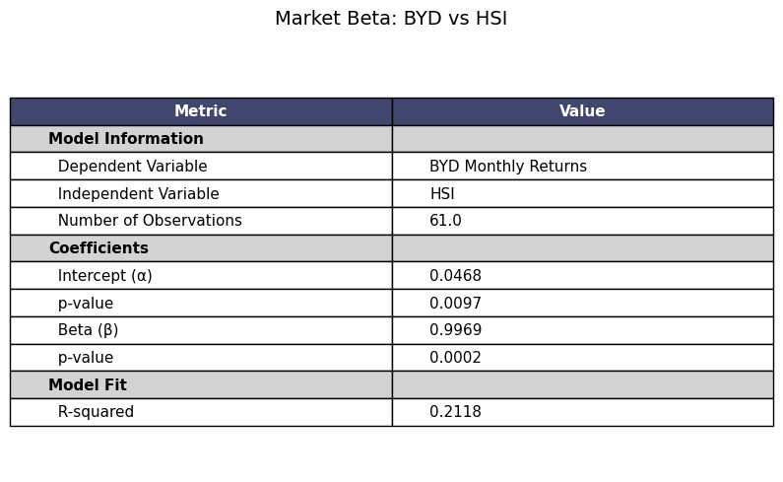
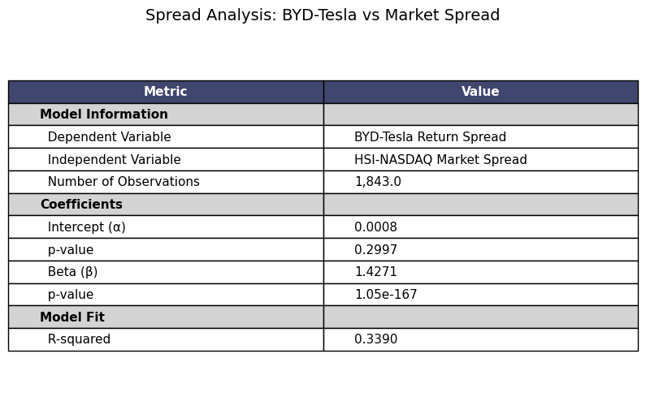
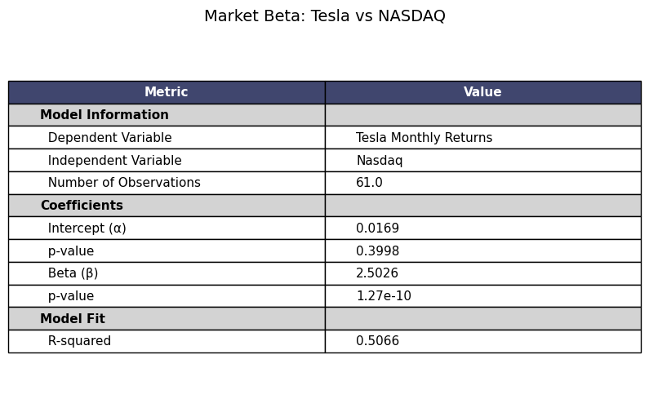
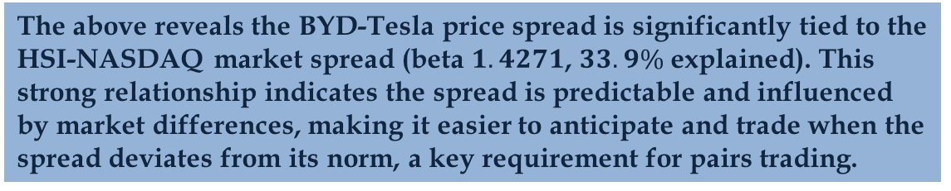
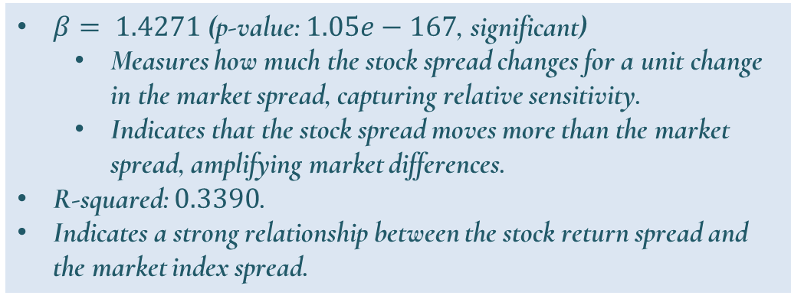
Quantitative Analysis: Market Beta Analysis
Tesla’s returns are highly tied to the NASDAQ (50.66% explained), while BYD’s are less tied to the HSI (21.18% explained); their price difference follows market trends (33.9% explained).
$$BYD−Tesla Spread = α+ β⋅HSI−NASDAQ Spread + ε$$
$β= 1.4271$ (p-value: $1.05e−167$, significant)
  Measures how much the stock spread changes for a unit change in the market spread, capturing relative sensitivity.
  Indicates that the stock spread moves more than the market spread, amplifying market differences.
R-squared: $0.3390$.
Indicates a strong relationship between the stock return spread and the market index spread.
The above reveals the BYD-Tesla price spread is significantly tied to the HSI-NASDAQ market spread (beta $1.4271$, $33.9\%$ explained). This strong relationship indicates the spread is predictable and influenced by market differences, making it easier to anticipate and trade when the spread deviates from its norm, a key requirement for pairs trading.

